Slide 1


High-Level Design
Team 7- Service Charge App
Version No: 1.0 Updated By: Lj Vincent Tudtud
Approved By:

Slide 2
Revision History
REV. NO | MODIFIED BY | MODIFIED DATE | REMARKS | PRELIMINARY REVIEW & APPROVAL | DATE REVIEWED | FINAL REVIEW & APPROVAL | DATE APPROVED
1.0 | Tudtud, Lj Vincent | 2023/02/04 | Initial Creation

Slide 3
Screen Details
Team - 7

Slide 4
Screen List
SCREEN | DESCRIPTION | REMARKS
1.0 Landing Page | The main page of the system.
1.1 Login | The modal for login within the landing page.
2.0 Forgot Password | The page for resetting passwords.
2.1 Reset Password | The page for creating a new password.
3.0 Dashboard | The page for viewing system features.
3.1 View / Update Ticket | The modal for ticket within the dashboard.
4.0 Add New User | The page for adding new users.
5.0 Add New Ticket | The page for creating new tickets.

Slide 5
Screen List
SCREEN | DESCRIPTION | REMARKS
6.0 Send Email | The page for sending emails.
7.0 View Users | The page for viewing a list of all.
8.0 Generate Conforme | The page for generating conformity reports.
9.0 Generate Report | The page for generating reports.
10.0 Logout | The page for logging out of the system.

Slide 6
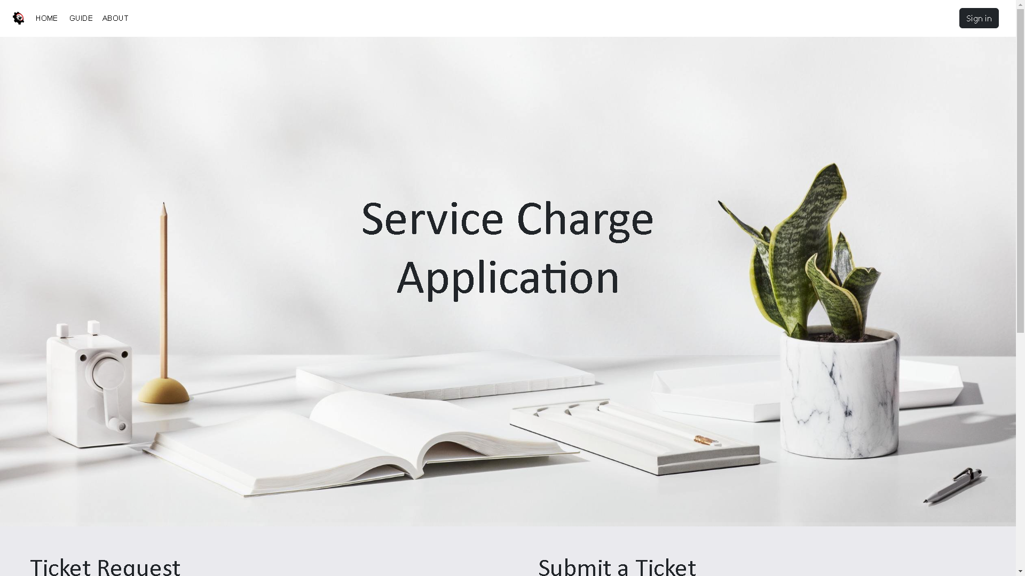
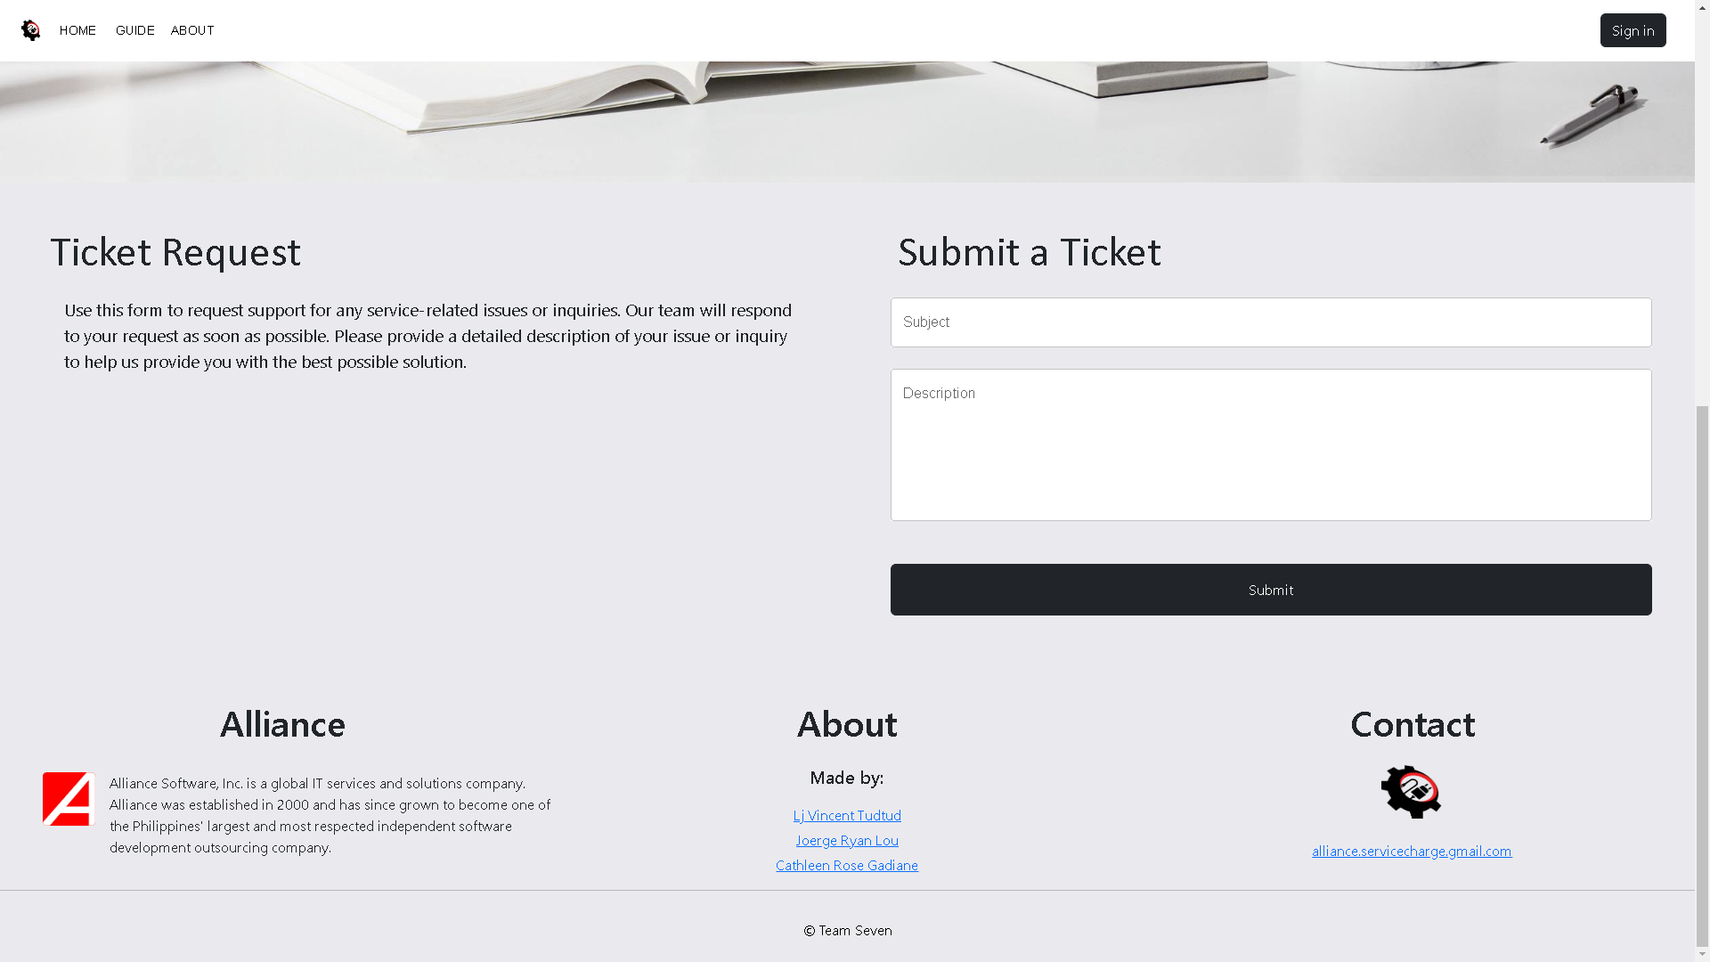
Landing Page
1.0

Slide 7
1.0 Landing Page Logic
ITEMS | TYPE | REQUIRED? | DATA TYPE | SIZE | FORMAT | SAMPLE DATA
Home | Button | N/A | N/A | N/A | N/A | N/A
Guide | Button | N/A | N/A | N/A | N/A | N/A
About | Button | N/A | N/A | N/A | N/A | N/A
Sign In | Button | N/A | N/A | N/A | N/A | N/A
Subject | Textbox | No | String | 255 | Text | Subject
Description | Textbox | No | String | 500 | Text | Description
Submit | Button | N/A | N/A | N/A | N/A | N/A
Made by | Textlink | N/A | N/A | N/A | N/A | N/A
Contact | Textlink | N/A | N/A | N/A | N/A | N/A
LOGIC
1.0 When the “Home” button is clicked, it will redirect to Landing Page. When the “Sign In” button is clicked, you will directed to the Login.

Slide 8
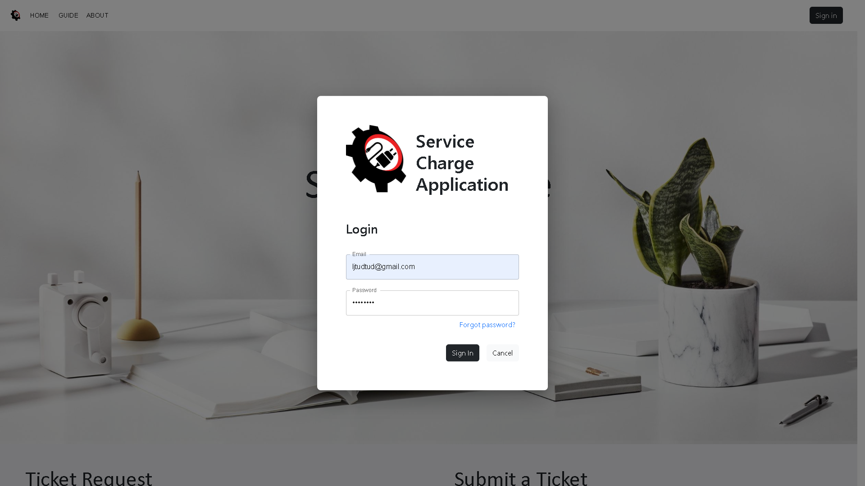
1.1 Login

Slide 9
1.1 Login Logic
ITEMS | TYPE | REQUIRED? | DATA TYPE | SIZE | FORMAT | SAMPLE DATA
Email | Textfield | Yes | varchar | 255 | text | ljtudtud@gmail.com
Password | Textfield | Yes | varchar | 255 | password | admin
Forgot Password | Textlink | N/A | N/A | N/A | N/A | N/A
Sign In | Button | N/A | N/A | N/A | N/A | N/A
Cancel | Button | N/A | N/A | N/A | N/A | N/A
LOGIC
1.1 Fill in the email and password When the “Sign in” button is clicked, it will direct to the Dashboard. If one of the required field is empty, an error message will display.
1.1.1 When the “Forgot Password” is clicked, a modal will pop-up for Forgot Password.

Slide 10
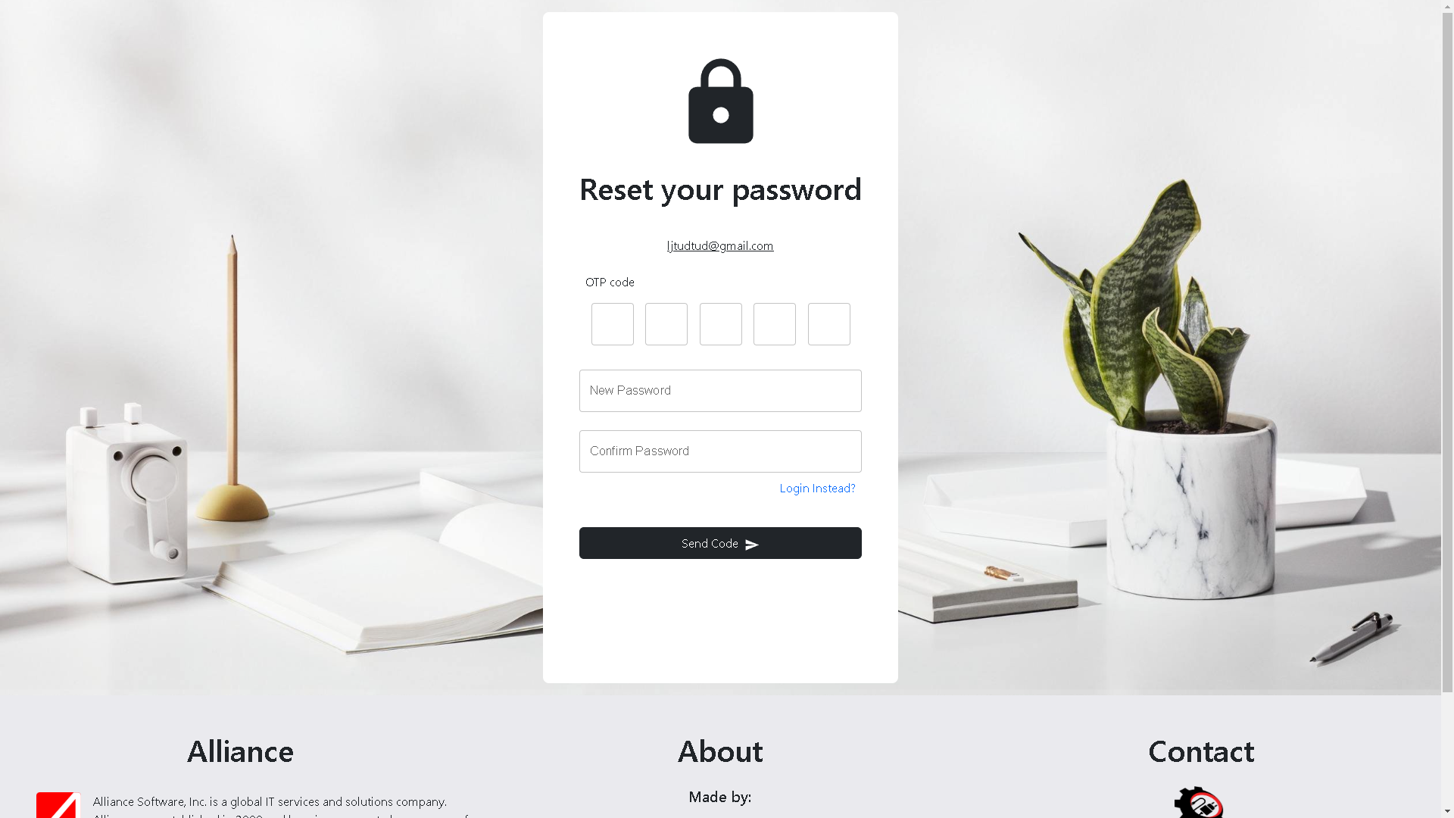
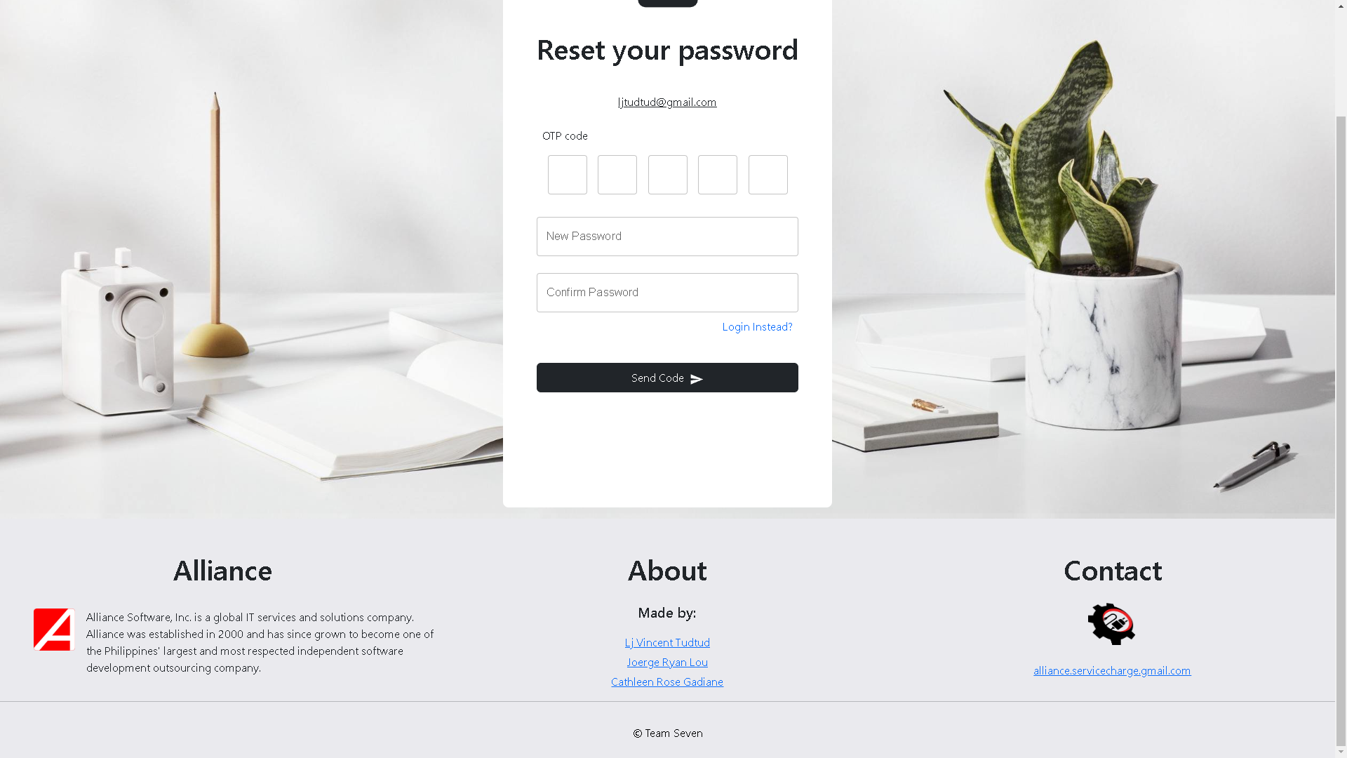
2.0 Forgot Password

Slide 11
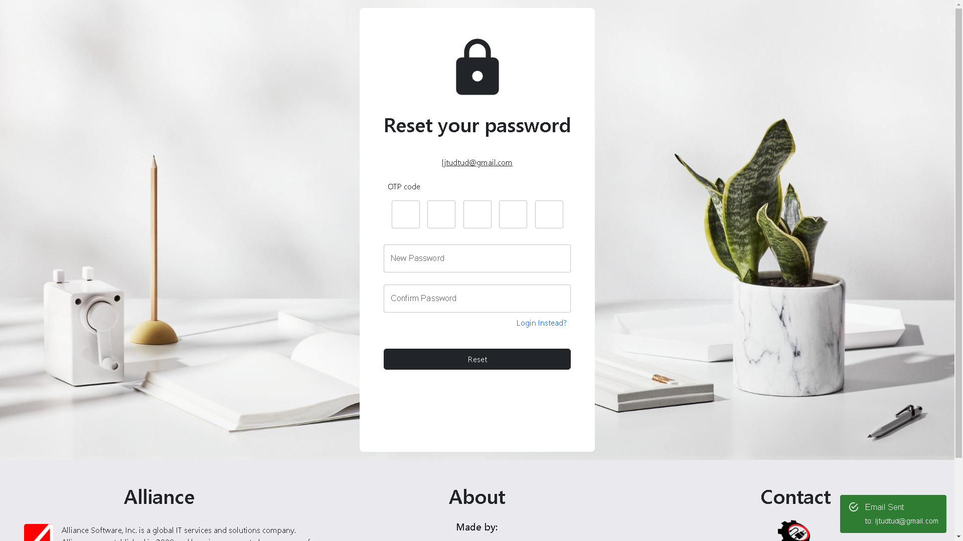
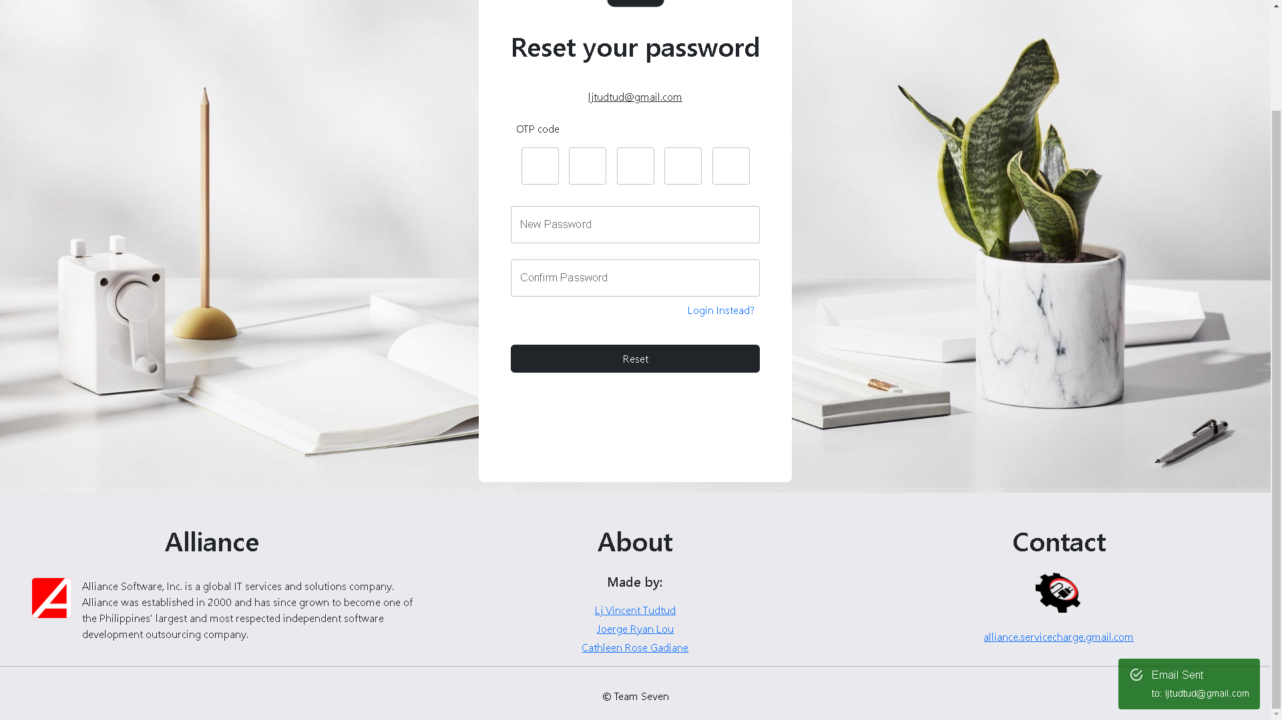
2.1 Reset Password

Slide 12
2.0 Forgot Password Logic
ITEMS | TYPE | REQUIRED? | DATA TYPE | SIZE | FORMAT | SAMPLE DATA
OTP Code | Textfield | Yes | varchar | 255 | text | 73154
New Password | Textfield | Yes | varchar | 255 | password | admin123
Confirm Password | Textfield | Yes | varchar | 255 | password | admin123
Send Code | Button | N/A | N/A | N/A | N/A | N/A
Reset | Button | N/A | N/A | N/A | N/A | N/A
LOGIC
1.1.1 After clicking the “Send Code” button, a message containing the OTP Code will be sent to the email. Fill in the OTP Code, New Password, & Confirm Password, then click the “Reset” button.

Slide 13
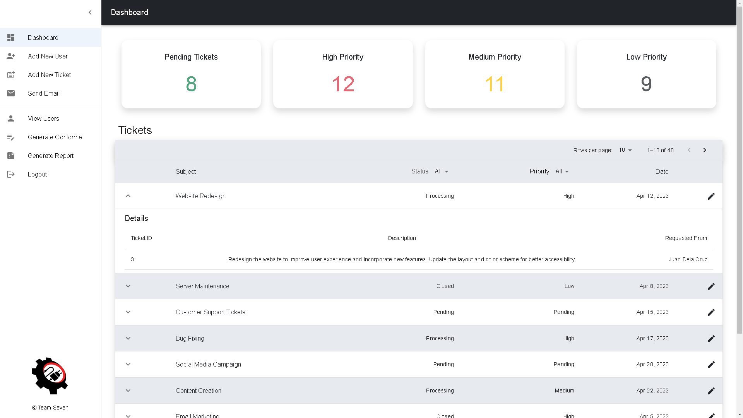
3.0 Dashboard

Slide 14
3.0 Dashboard Logic
ITEMS | TYPE | REQUIRED? | DATA TYPE | SIZE | FORMAT | SAMPLE DATA
Pending Tickets | Button | N/A | N/A | N/A | N/A | N/A
High Priority | Button | N/A | N/A | N/A | N/A | N/A
Medium Priority | Button | N/A | N/A | N/A | N/A | N/A
Low Priority | Button | N/A | N/A | N/A | N/A | N/A
LOGIC
2.0 When the “Pending Tickets” button is clicked, the table will display all the pending tickets. When the “High Priority” button is clicked, the table will display all the high priority tickets. When the “Medium Priority” button is clicked, the table will display all the medium priority tickets. When the “Low Priority” button is clicked, the table will display all the low priority tickets.
2.1 If the pen icon is clicked, a modal will pop-up for update ticket at the same time you can view the ticket details.

Slide 15
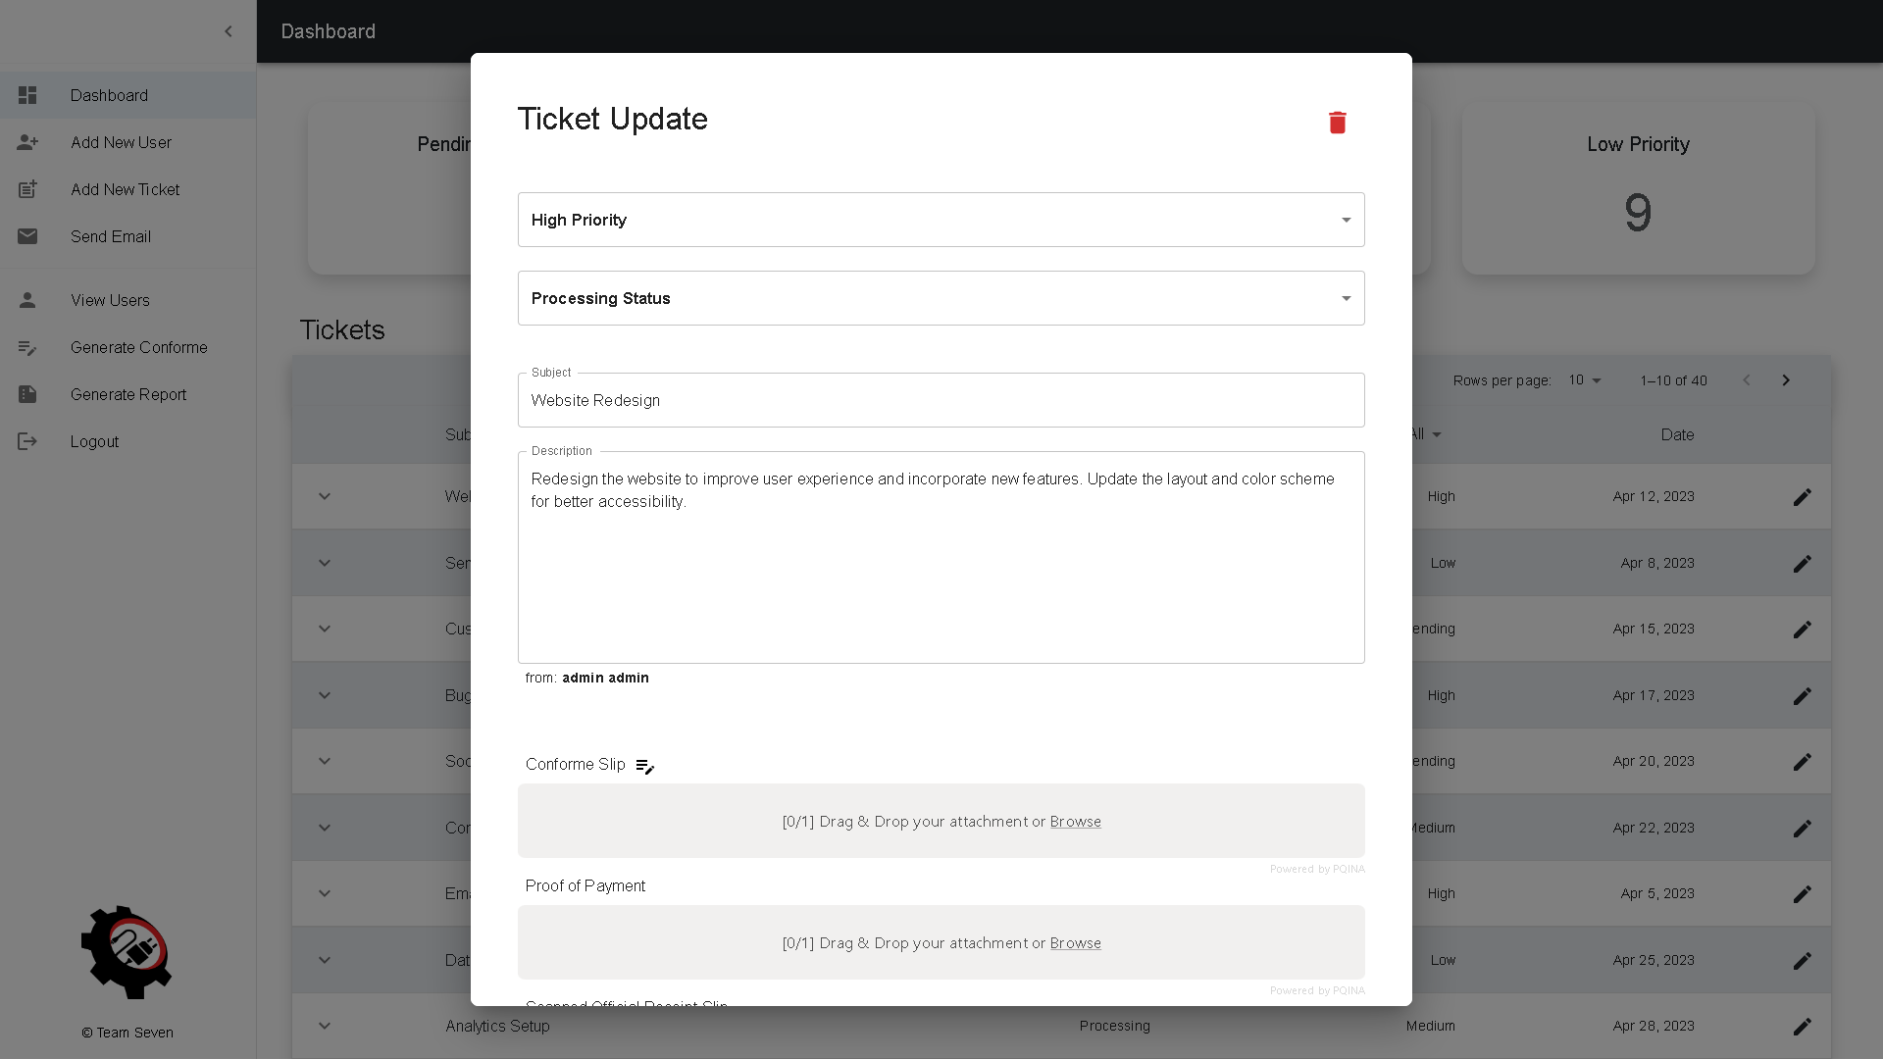
3.1 View / Update Ticket

Slide 16
3.1 View / Update Ticket Logic
ITEMS | TYPE | REQUIRED? | DATA TYPE | SIZE | FORMAT | SAMPLE DATA
Priority | Dropdown | Yes | varchar | N/A | N/A | Low Priority
Status | Dropdown | Yes | varchar | N/A | N/A | Processing Status
Subject | Textbox | Yes | varchar | 255 | Text | Website Redesign
Description | Textbox | Yes | varchar | 500 | Text | Description
Conforme Slip | File Upload | No | File | N/A | N/A | Image
Proof of Payment | File Upload | No | File | N/A | N/A | Image
Scanned Official Receipt Slip | File Upload | No | File | N/A | N/A | Image
Save | Button | No | N/A | N/A | N/A | Save

Slide 17
3.1 View / Update Ticket Logic
ITEMS | TYPE | REQUIRED? | DATA TYPE | SIZE | FORMAT | SAMPLE DATA
Cancel | Button | No | N/A | N/A | N/A | Cancel
Trash Icon | Button | No | N/A | N/A | N/A | Delete
LOGIC
2.1 Fill in all required fields When the “Save” button is clicked, the value/s will be updated and a confirmation will display. When the trash icon is clicked, the data will be deleted and a confirmation will display.

Slide 18
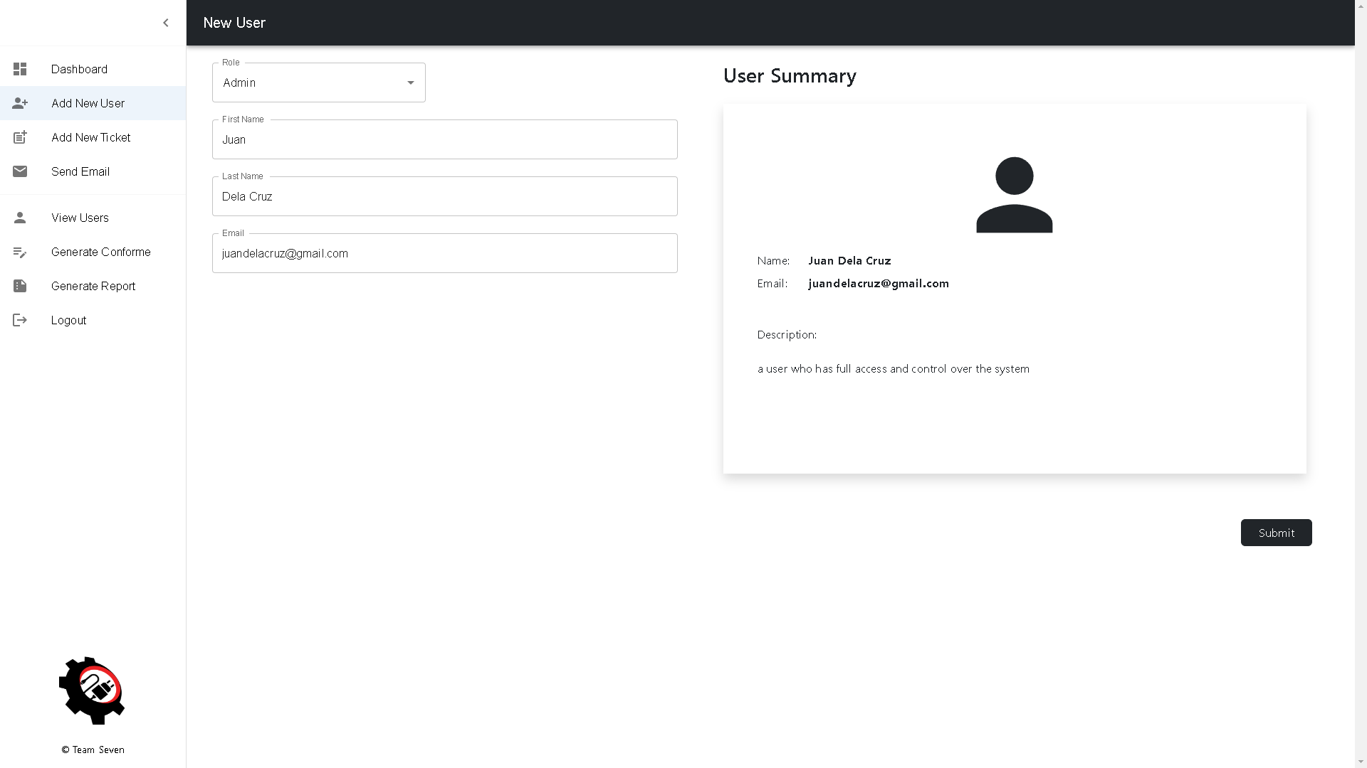
4.0 Add New User

Slide 19
4.0 Add New User Logic
ITEMS | TYPE | REQUIRED? | DATA TYPE | SIZE | FORMAT | SAMPLE DATA
Role | Dropdown | Yes | varchar | N/A | N/A | Admin
First Name | Textfield | Yes | varchar | 255 | text | Juan
Last Name | Textfield | Yes | varchar | 255 | text | Dela Cruz
Email | Textfield | Yes | varchar | 255 | text | juandelacruz@gmail.com
Submit | Button | N/A | N/A | N/A | N/A | N/A
LOGIC
3.0 When a value is selected in the “Role” dropdown, the details will be displayed in the User Summary After adding a value in the “First Name” & “Last Name” field, it will display in the User Summary When the “Submit” button is clicked, the user will be added and displayed on the View User page

Slide 20
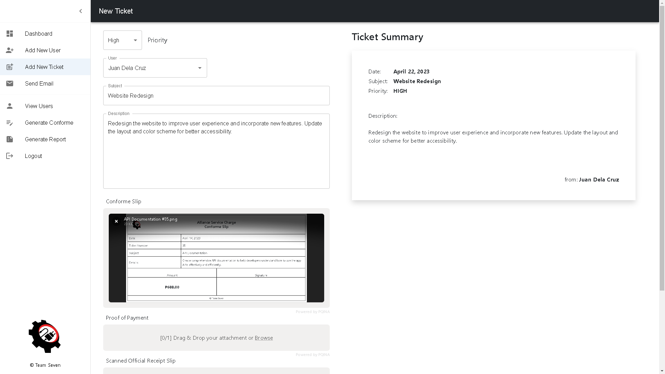
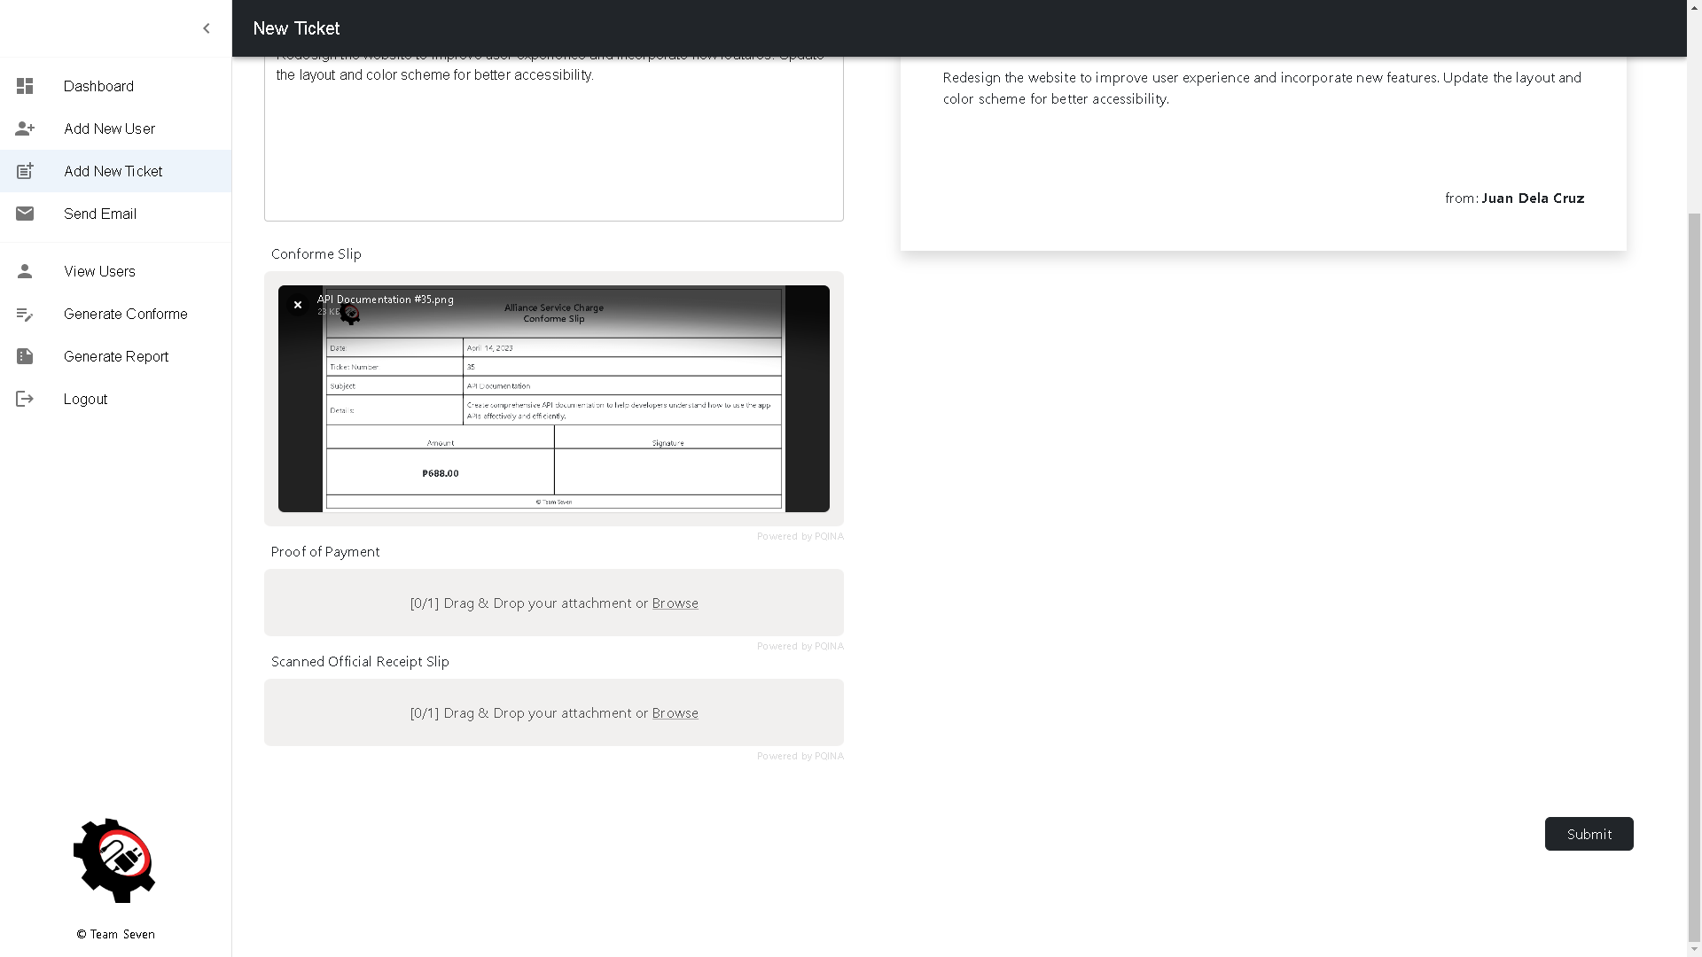
Add New Ticket
5.0

Slide 21
5.0 Add New Ticket Logic
ITEMS | TYPE | REQUIRED? | DATA TYPE | SIZE | FORMAT | SAMPLE DATA
Priority | Dropdown | Yes | varchar | 255 | N/A | HighPriority
User | Dropdown | Yes | varchar | 255 | N/A | Juan Dela Cruz
Subject | Textbox | Yes | varchar | 255 | Text | Website Redesign
Description | Textbox | Yes | varchar | 500 | Text | Description
Conforme Slip | File Upload | Yes | String | N/A | N/A | Image
Proof of Payment | File Upload | Yes | String | N/A | N/A | Image
Scanned Official Receipt Slip | File Upload | Yes | String | N/A | N/A | Image
Submit | Button | Yes | N/A | N/A | N/A | N/A
LOGIC
4.0 Fill in the New Ticket form and upload a valid file If one of the required fields is empty, an error message displays.

Slide 22
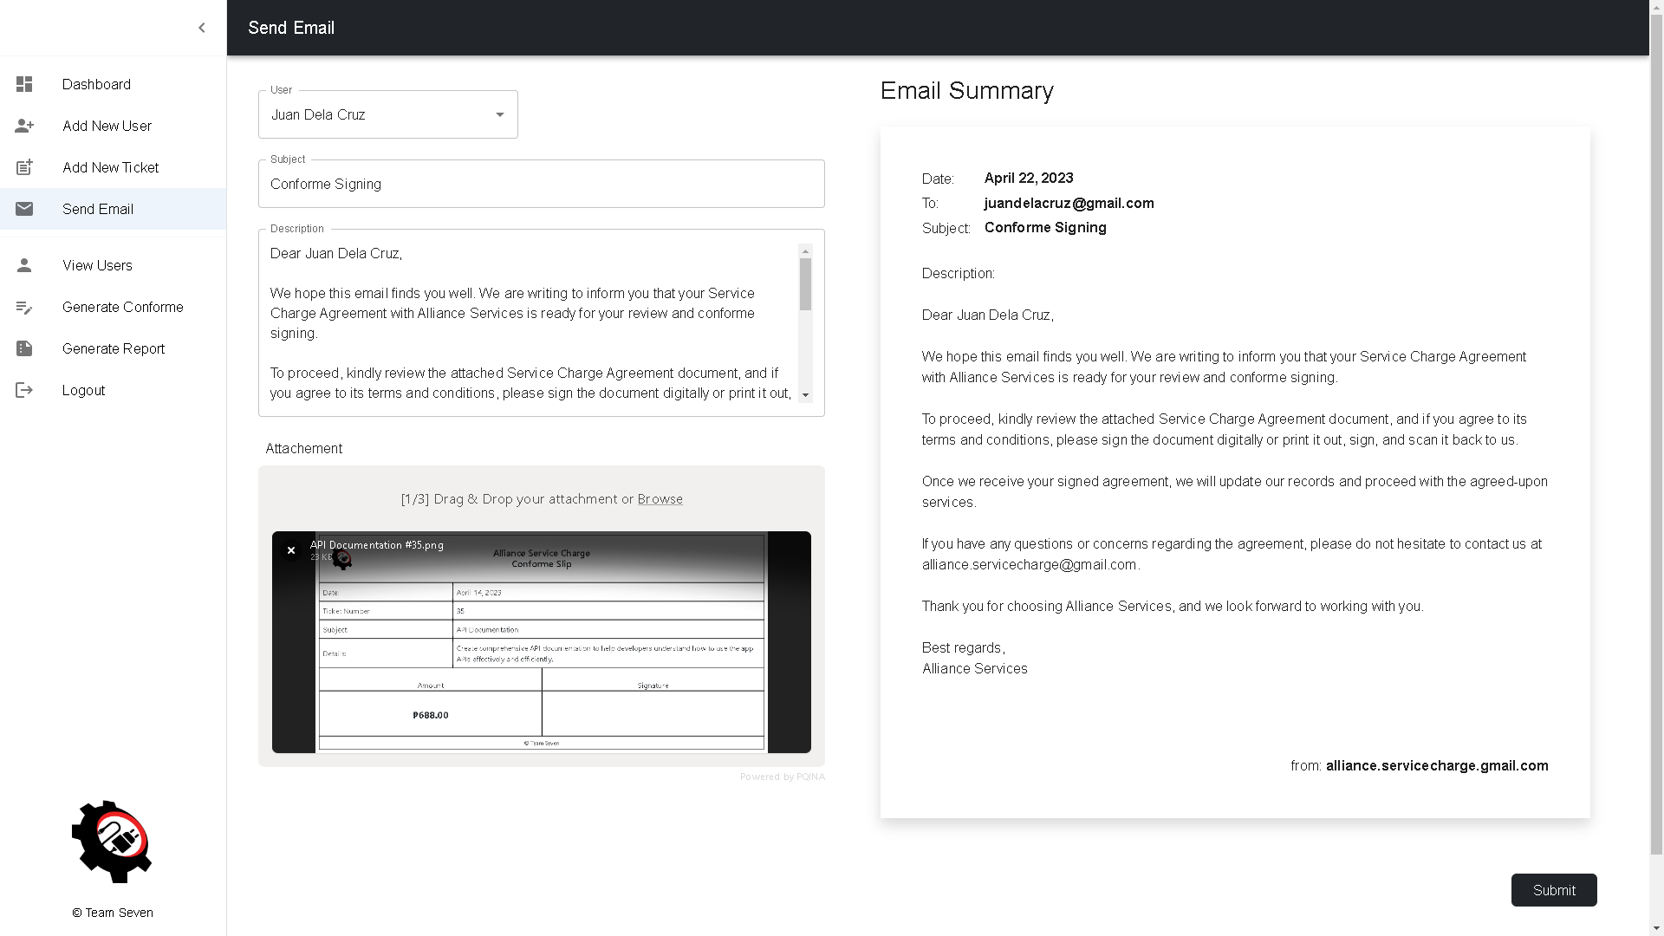
6.0 Send Email

Slide 23
6.0 Send Email Logic
ITEMS | TYPE | REQUIRED? | DATA TYPE | SIZE | FORMAT | SAMPLE DATA
User | Dropdown | Yes | varchar | 255 | N/A | Juan Dela Cruz
Subject | Textbox | Yes | varchar | 255 | Text | Website Redesign
Description | Textbox | Yes | varchar | 500 | Text | Description
Attachment | File Upload | Yes | String | N/A | N/A | Image
Submit | Button | Yes | N/A | N/A | N/A | N/A
LOGIC
5.0 After filling in the fields, it will display on the Email Summary part. When the “Submit” button is clicked, an email will be sent.

Slide 24
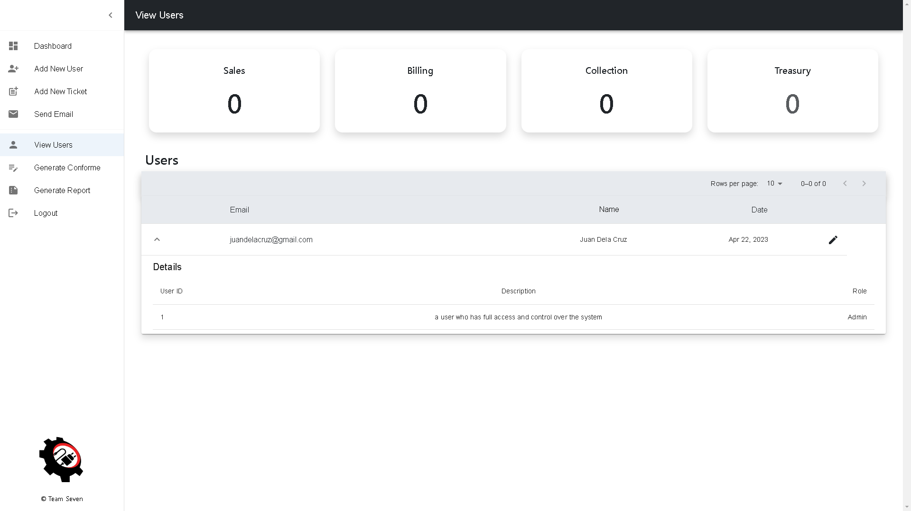
7.0 View Users

Slide 25
7.0 View Users Logic
ITEMS | TYPE | REQUIRED? | DATA TYPE | SIZE | FORMAT | SAMPLE DATA
Sales | Button | N/A | N/A | N/A | N/A | N/A
Billing | Button | N/A | N/A | N/A | N/A | N/A
Collection | Button | N/A | N/A | N/A | N/A | N/A
Treasury | Button | N/A | N/A | N/A | N/A | N/A
LOGIC
2.0 When the “Sales” button is clicked, the table will display all the users belong to Sales. When the “Billing” button is clicked, the table will display all the users belong to Billing. When the “Collection” button is clicked, the table will display all the users belong to Collection. When the “Treasury” button is clicked, the table will display all the users belong to Treasury.

Slide 26
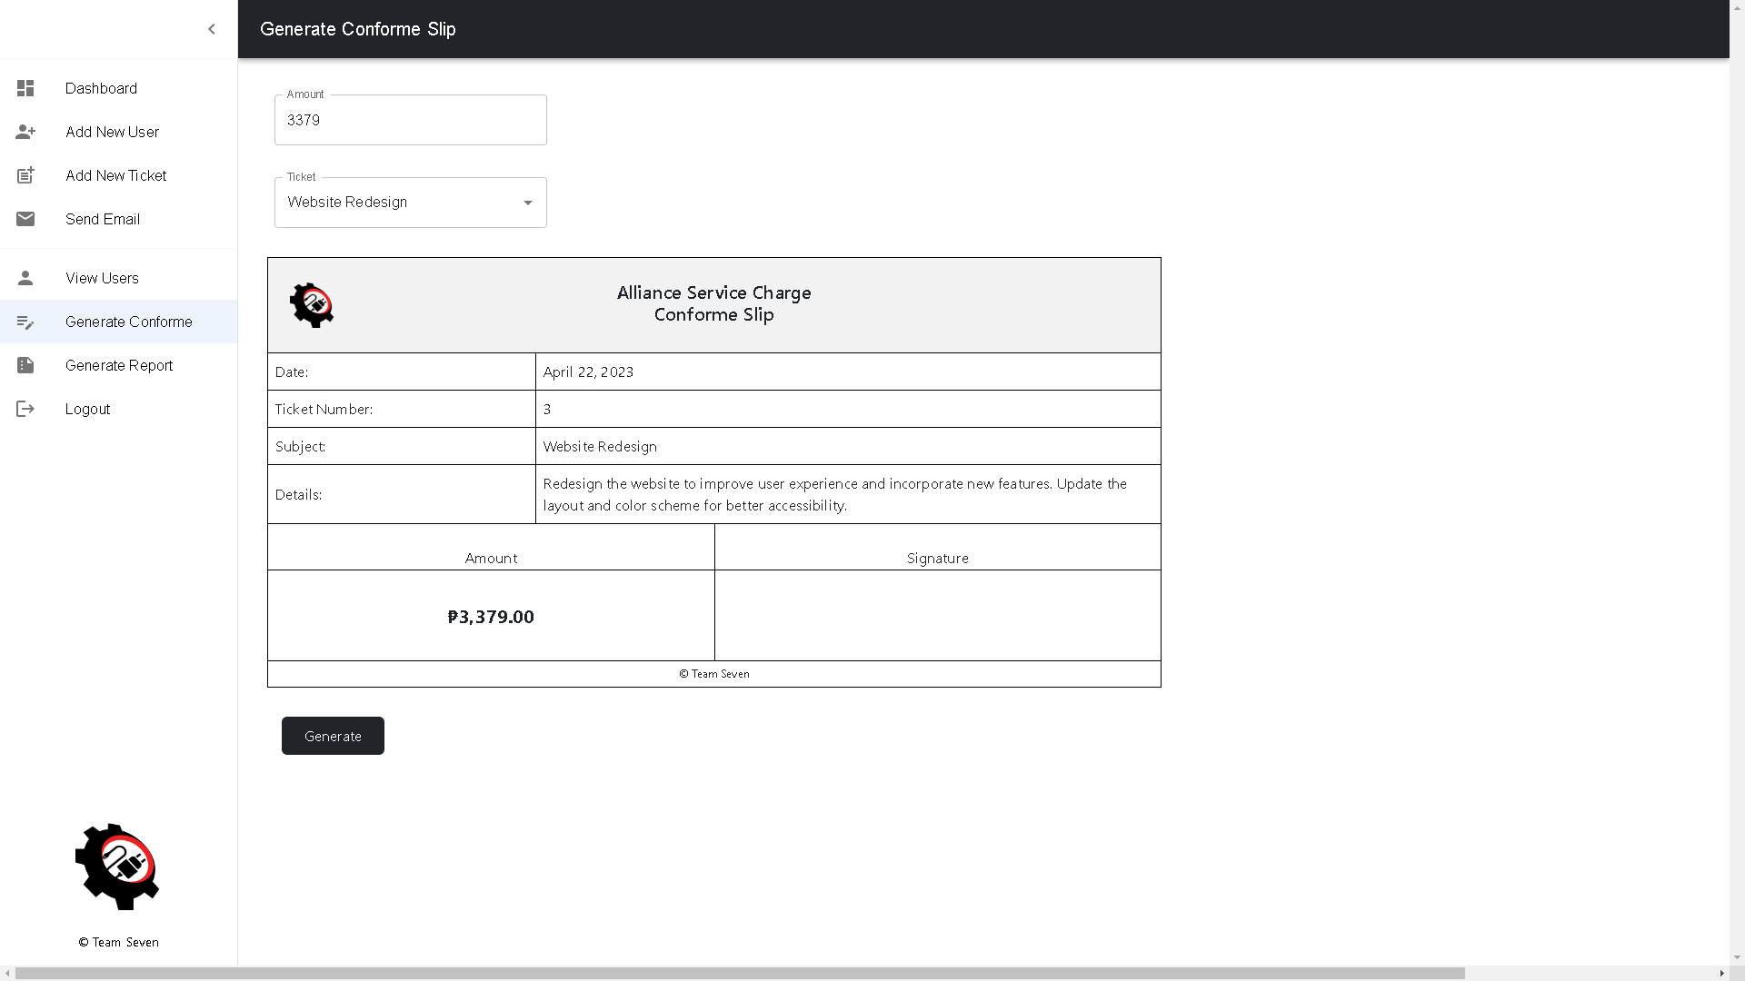
8.0 Generate Conforme

Slide 27
8.0 Generate Conforme Logic
ITEMS | TYPE | REQUIRED? | DATA TYPE | SIZE | FORMAT | SAMPLE DATA
Amount | Textbox | Yes | int | N/A | N/A | 3379
Ticket | Dropdown | Yes | varchar | 255 | N/A | Website Redesign
Generate | Button | Yes | NA | N/A | N/A | N/A
LOGIC
6.0 After adding a value in the “Amount” field, it will display in the Generate Conforme Slip form. When a value is selected in the “Ticket” dropdown, the details will be displayed in the Generate Conforme Slip form. When the “Generate” button is clicked, an image will be generated and downloaded.

Slide 28
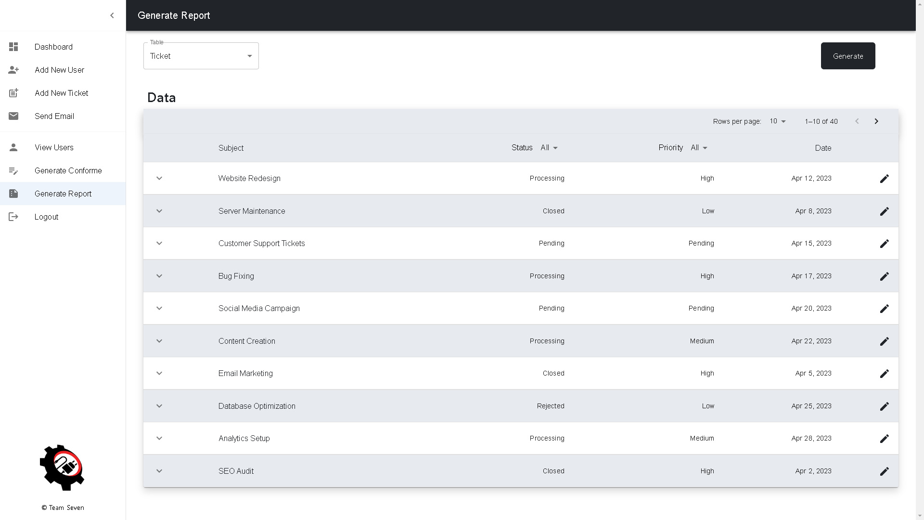
9.0 Generate Report

Slide 29
9.0 Generate Report Logic
ITEMS | TYPE | REQUIRED? | DATA TYPE | SIZE | FORMAT | SAMPLE DATA
Table | Dropdown | Yes | varchar | N/A | N/A | Ticket
Generate | Button | Yes | N/A | N/A | N/A | N/A
LOGIC
7.0 When a value is selected in the “Table” dropdown, the table will filter and display the selected value. When the “Generate” button is clicked, a file will be generated and downloaded.

Slide 30
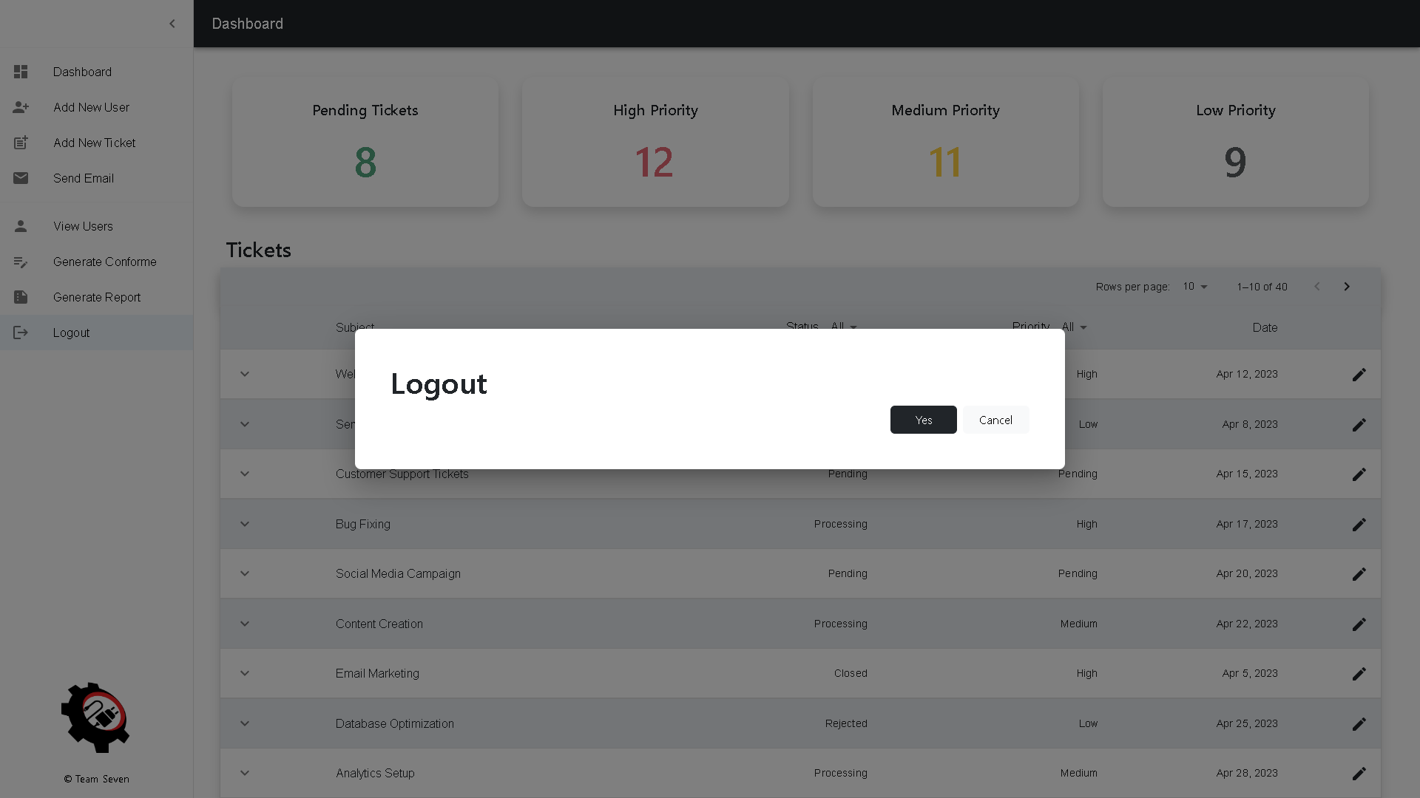
10.0 Logout

Slide 31
10.0 Logout Logic
ITEMS | TYPE | REQUIRED? | DATA TYPE | SIZE | FORMAT | SAMPLE DATA
Yes | Button | N/A | N/A | N/A | N/A | N/A
Cancel | Button | N/A | N/A | N/A | N/A | N/A
LOGIC
7.0 When the “Yes” button is clicked, you will be logout in your session and redirected to the Landing page. When the “Cancel” button is clicked, you will be redirected to the previous page.

